Slide 1
Machine learning
Mobile Price Classification
RAYYAN IBRAHIM

Slide 2
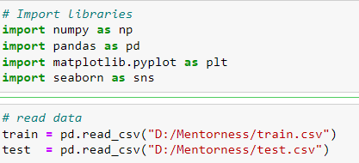
Importing and reading data
The first step is Importing necessary libraries such as (numpy, pandas, matplotlib and seaborn ) and reading data which is divided into train and test data

Slide 3
Exploring data
Target Variable
Features
Data has 2000 rows and 20 features
Price_range is the target variable No missing values and no duplicates
All categories has same size
0:low, 1: medium, 2:High, 3:very high Ram size is the most correlated feature to price_rang, (r = 0.92)

Slide 4
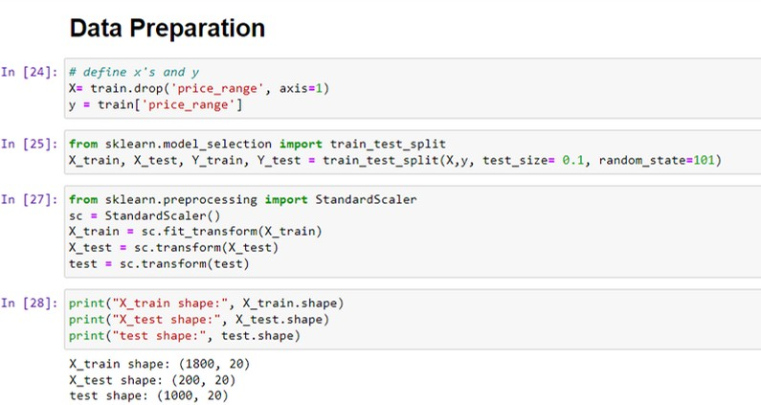
Data Preparation
Defining the features and the target variable Splitting the dataset
Standarizing data

Slide 5


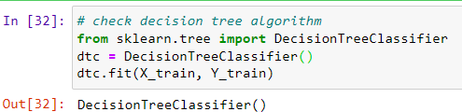
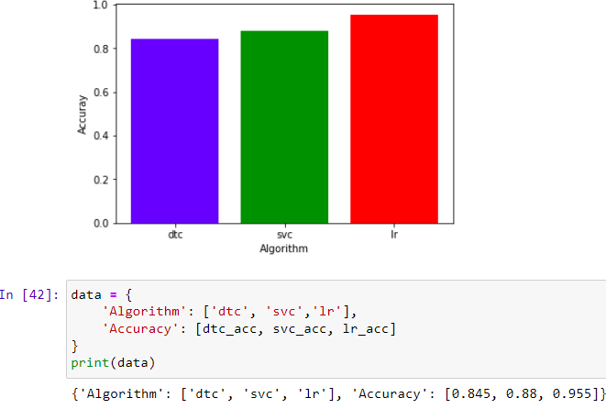




Checking the Algorithms
Decision Tree
Perfect Model
Logistic Regression has The highest accuracy (96%), so
it will be chosen as a classification model.
svc
Logistic Regression

Slide 6
Thank You
Rayyan Ibrahim
rayyanschool2@gmail.com
Linkedin

